Slide 2
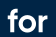
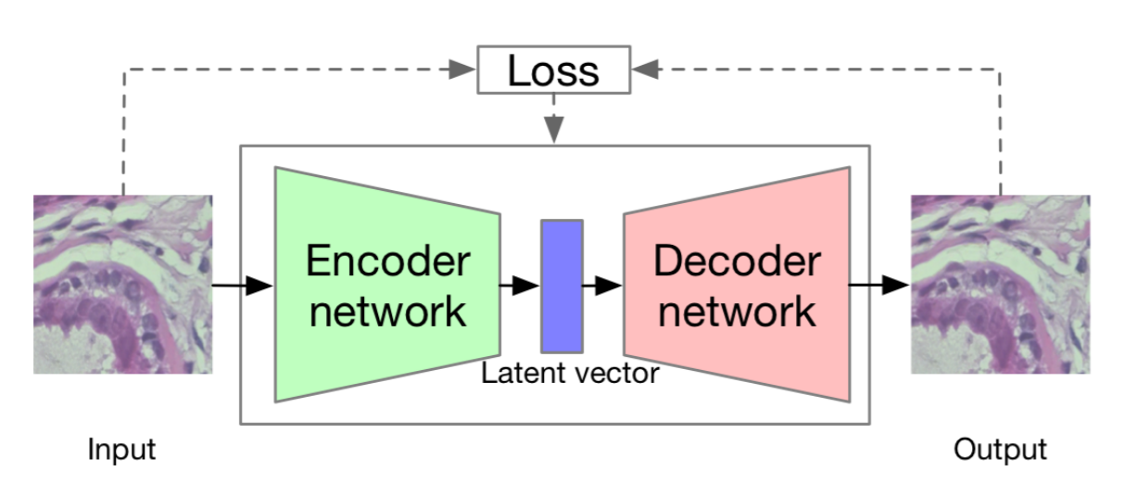
UNSUPERVISED GENERATIVE AUTOENCODERS
ENGINEERING MACHINE LEARNING
HEALTH TECHNOLOGY

Slide 3
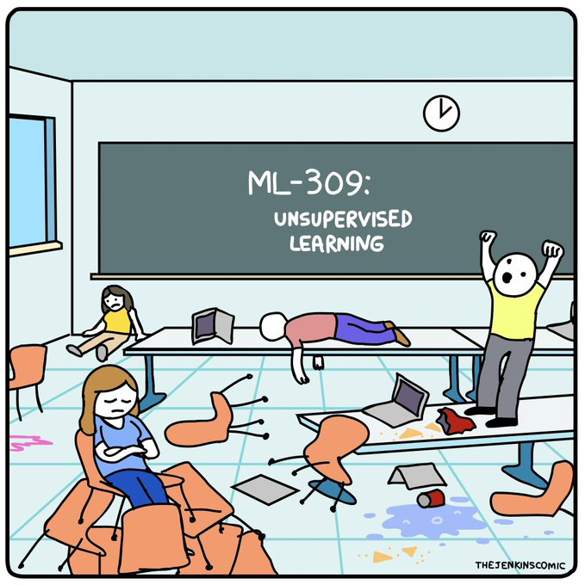
UNSUPERVISED LEARNING
DOES THE BRAIN DO IT, AND IF SO HOW?

Slide 4
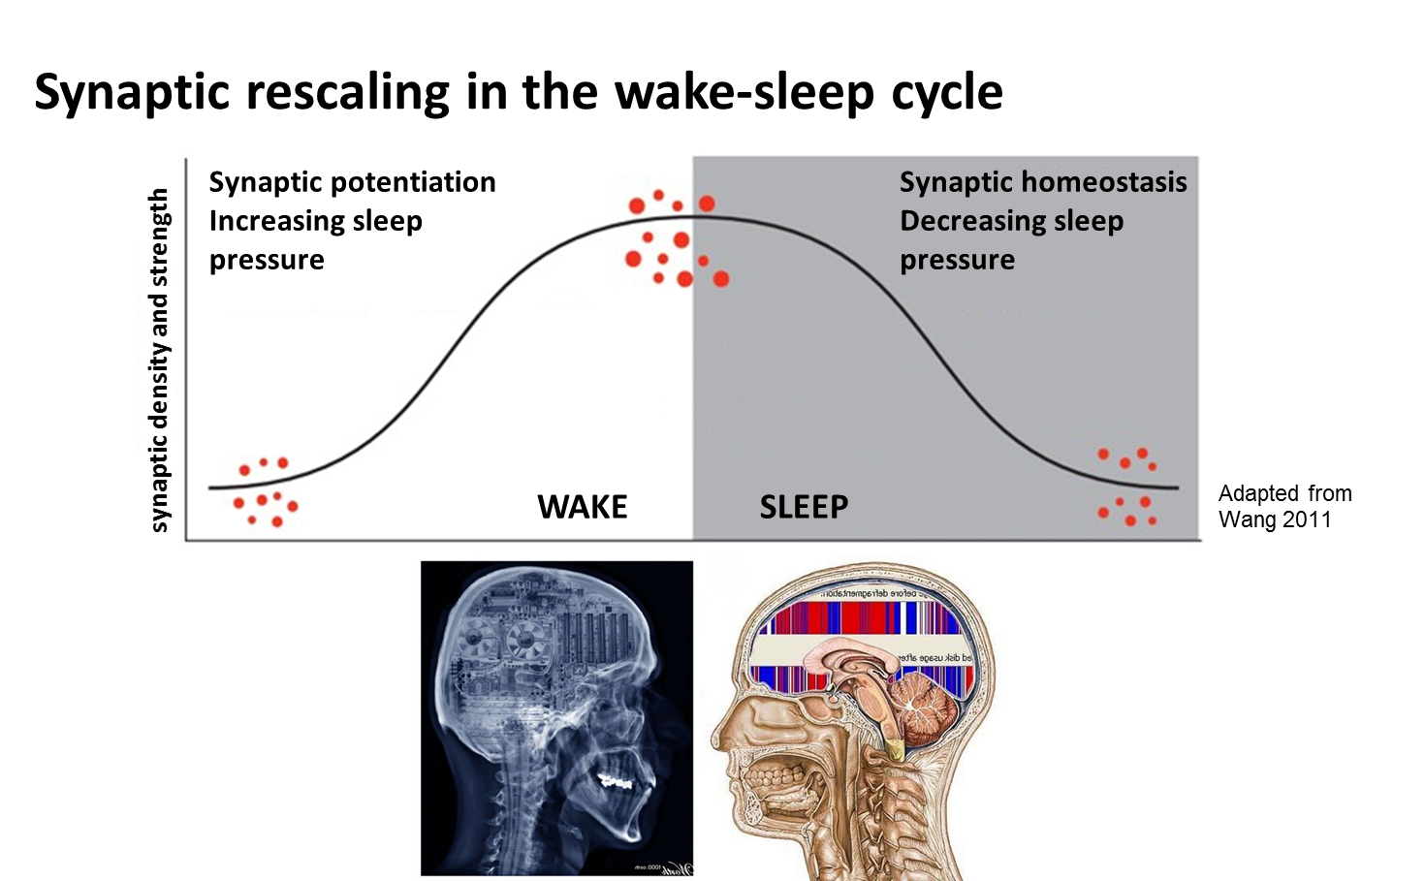
UNSUPERVISED LEARNING
DOES THE BRAIN DO IT, AND IF SO HOW?
Obs. Bad computational metaphor

Slide 5
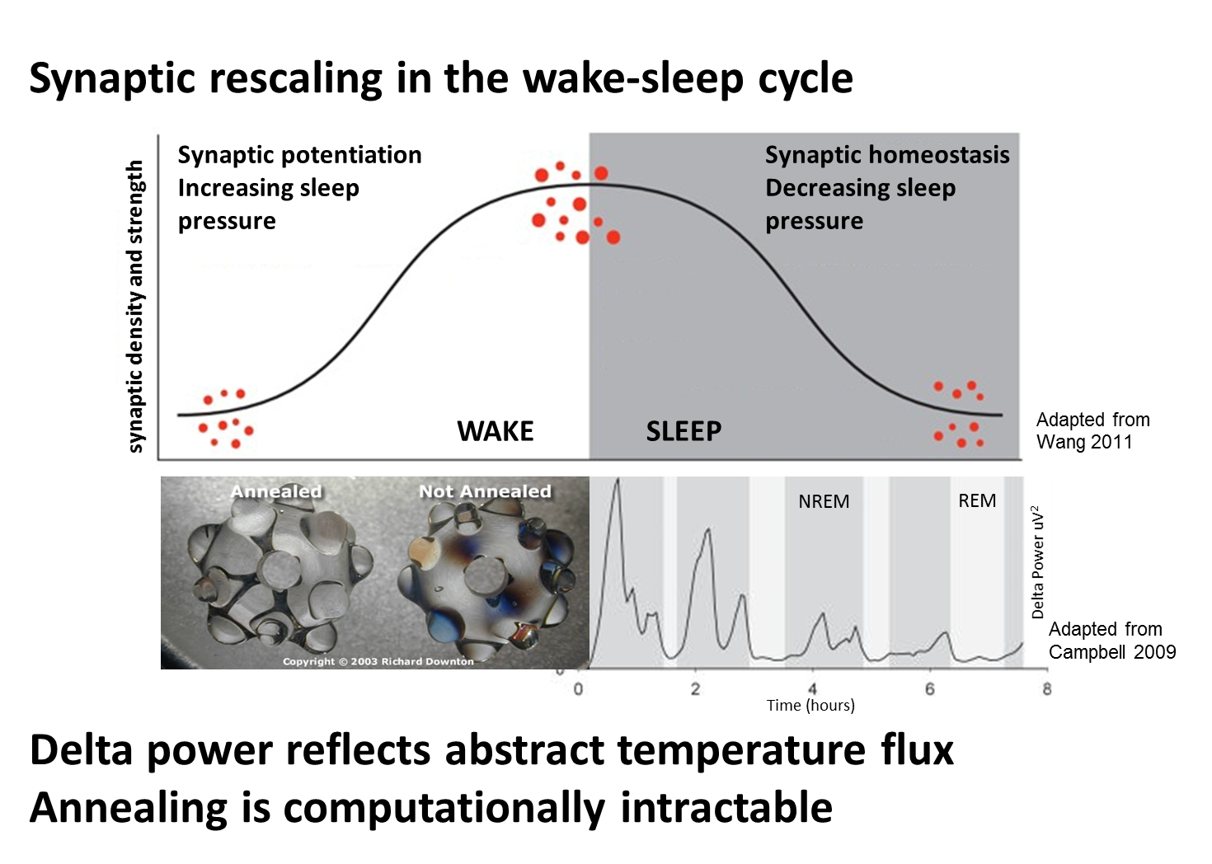
UNSUPERVISED LEARNING
DOES THE BRAIN DO IT, AND IF SO HOW?

Slide 6
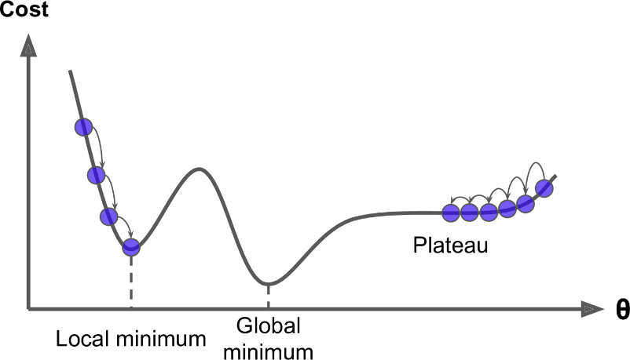
UNSUPERVISED LEARNING
DOES THE BRAIN DO IT, AND IF SO HOW?
OBS. Simulated annealing is intractable

Slide 7
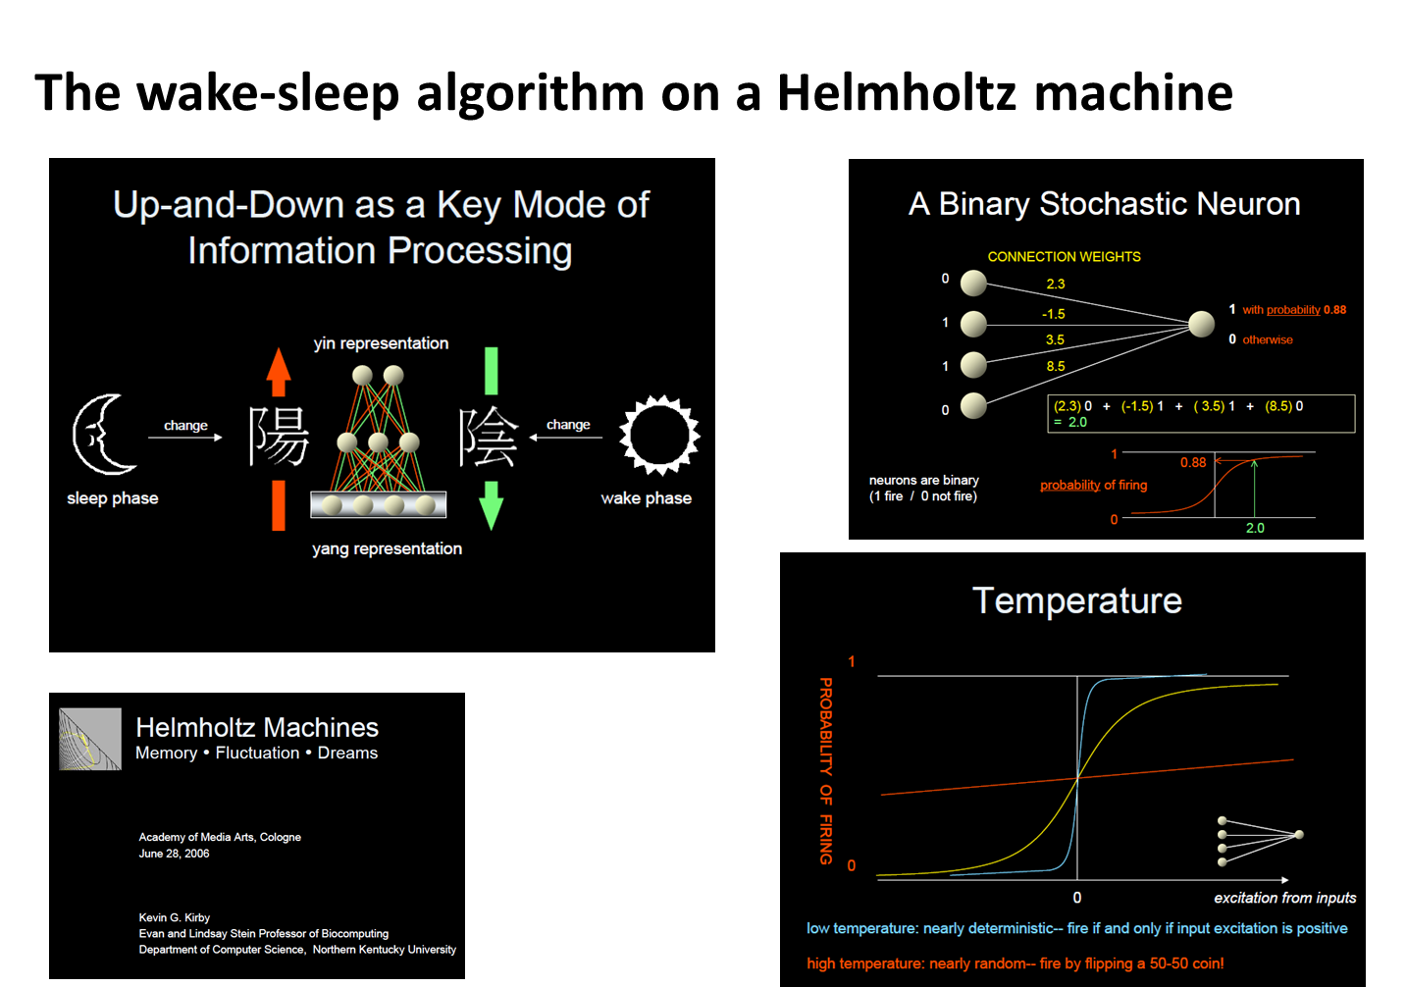
UNSUPERVISED LEARNING
THE HELMHOLTZ MACHINE – WAKE/SLEEP LEARNING

Slide 8
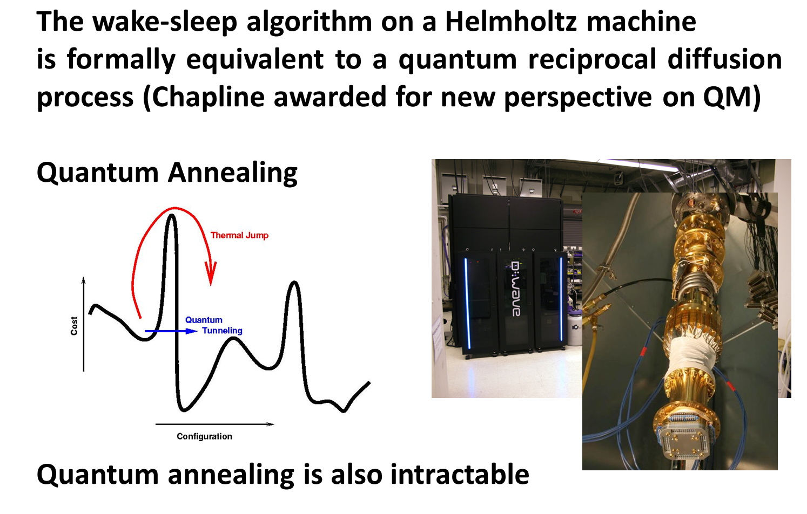
UNSUPERVISED LEARNING
THE HELMHOLTZ MACHINE – WAKE/SLEEP LEARNING

Slide 9
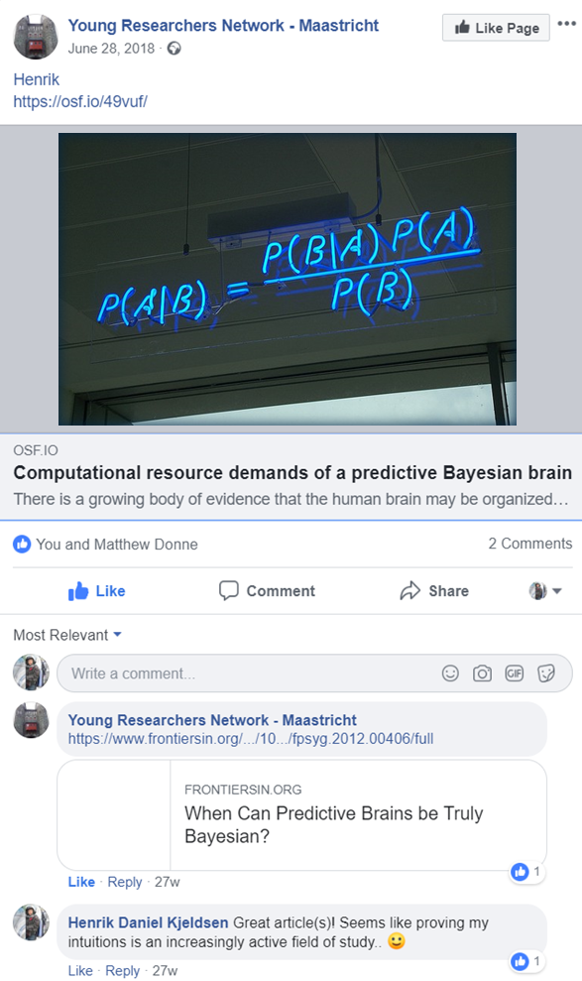
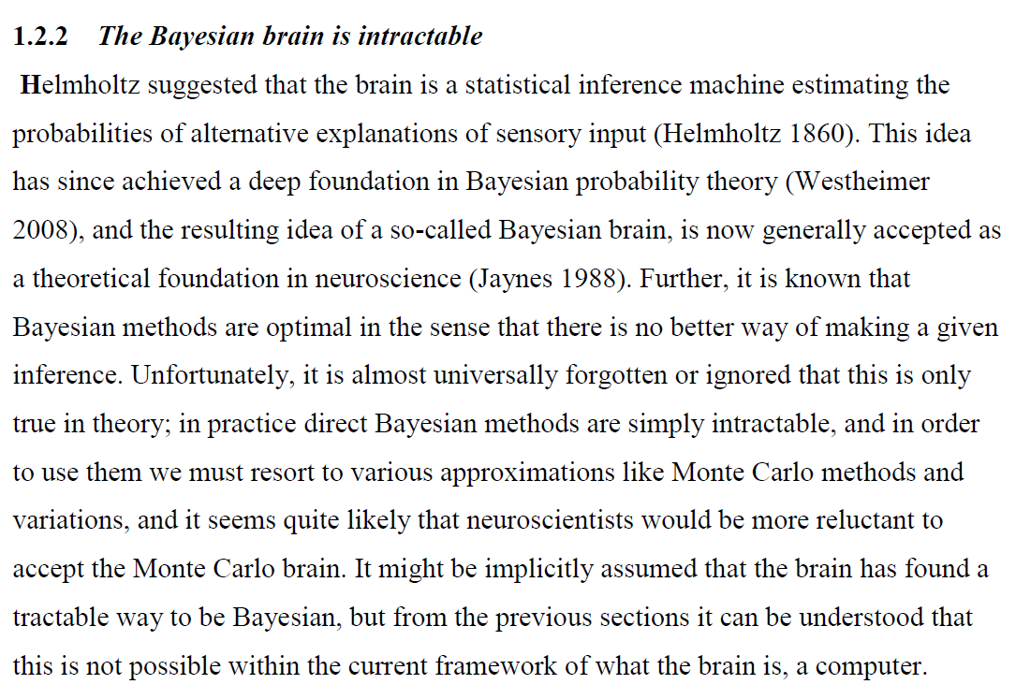
UNSUPERVISED LEARNING
OTHER THEORIES

Slide 10
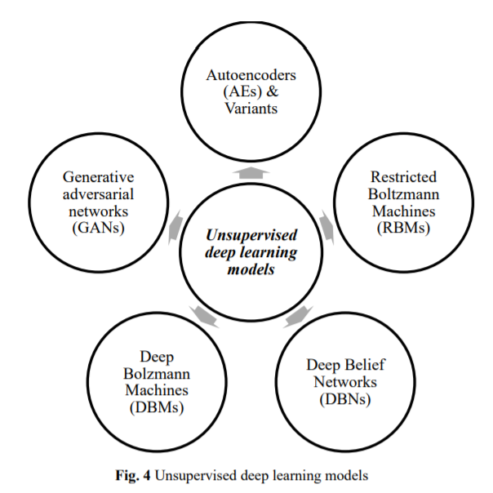
UNSUPERVISED LEARNING
https://arxiv.org/ftp/arxiv/papers/1812/1812.07715.pdf

Slide 11
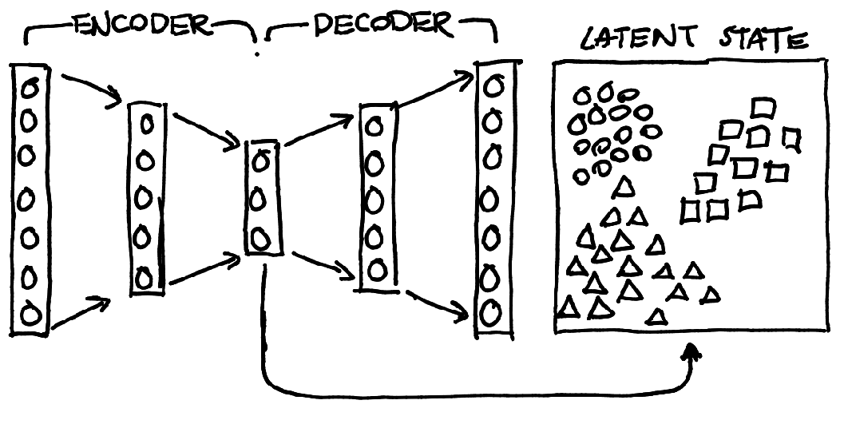
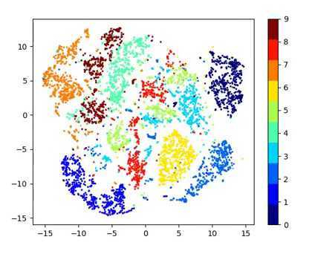
UNSUPERVISED LEARNING
AUTOENCODER LATENT SPACE
A typical latent space of an autoencoder on MNIST.
https://arxiv.org/ftp/arxiv/papers/1812/1812.07715.pdf

Slide 12
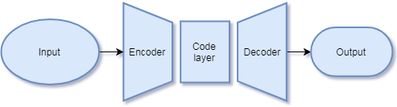
UNSUPERVISED LEARNING
AUTOENCODERS
https://arxiv.org/ftp/arxiv/papers/1812/1812.07715.pdf

Slide 13
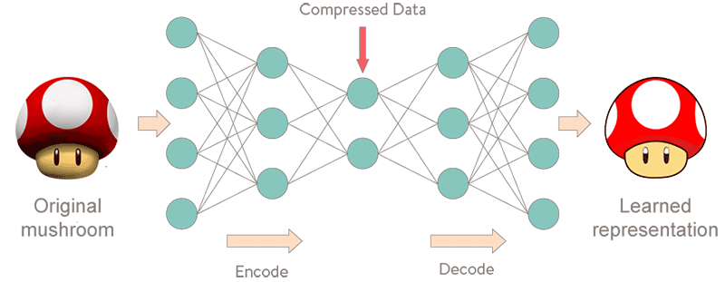
UNSUPERVISED LEARNING
AUTOENCODER DENOISING
https://arxiv.org/ftp/arxiv/papers/1812/1812.07715.pdf

Slide 14
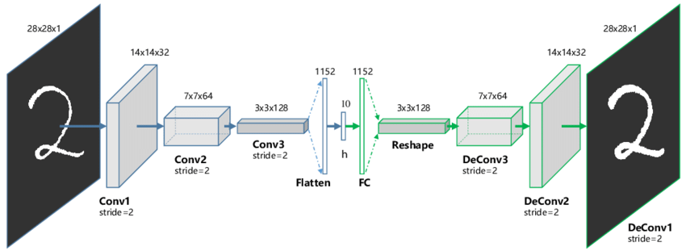
UNSUPERVISED LEARNING
AUTOENCODERS

Slide 15
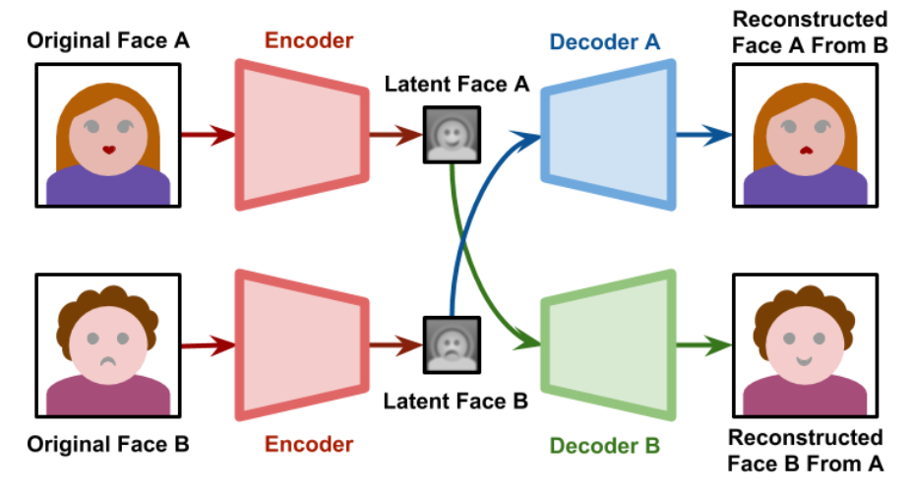
UNSUPERVISED LEARNING
AUTOENCODERS
https://www.alanzucconi.com/2018/03/14/understanding-the-technology-behind-deepfakes/

Slide 16
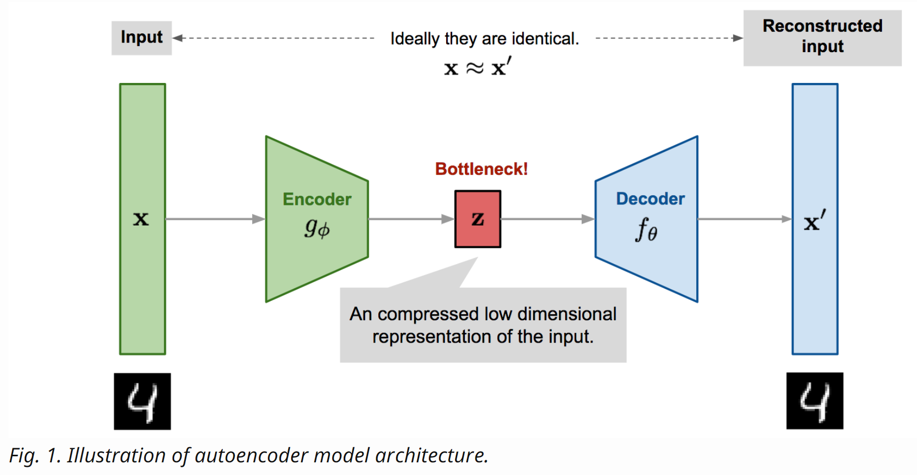
UNSUPERVISED LEARNING
AUTOENCODERS
https://lilianweng.github.io/lil-log/2018/08/12/from-autoencoder-to-beta-vae.html

Slide 17
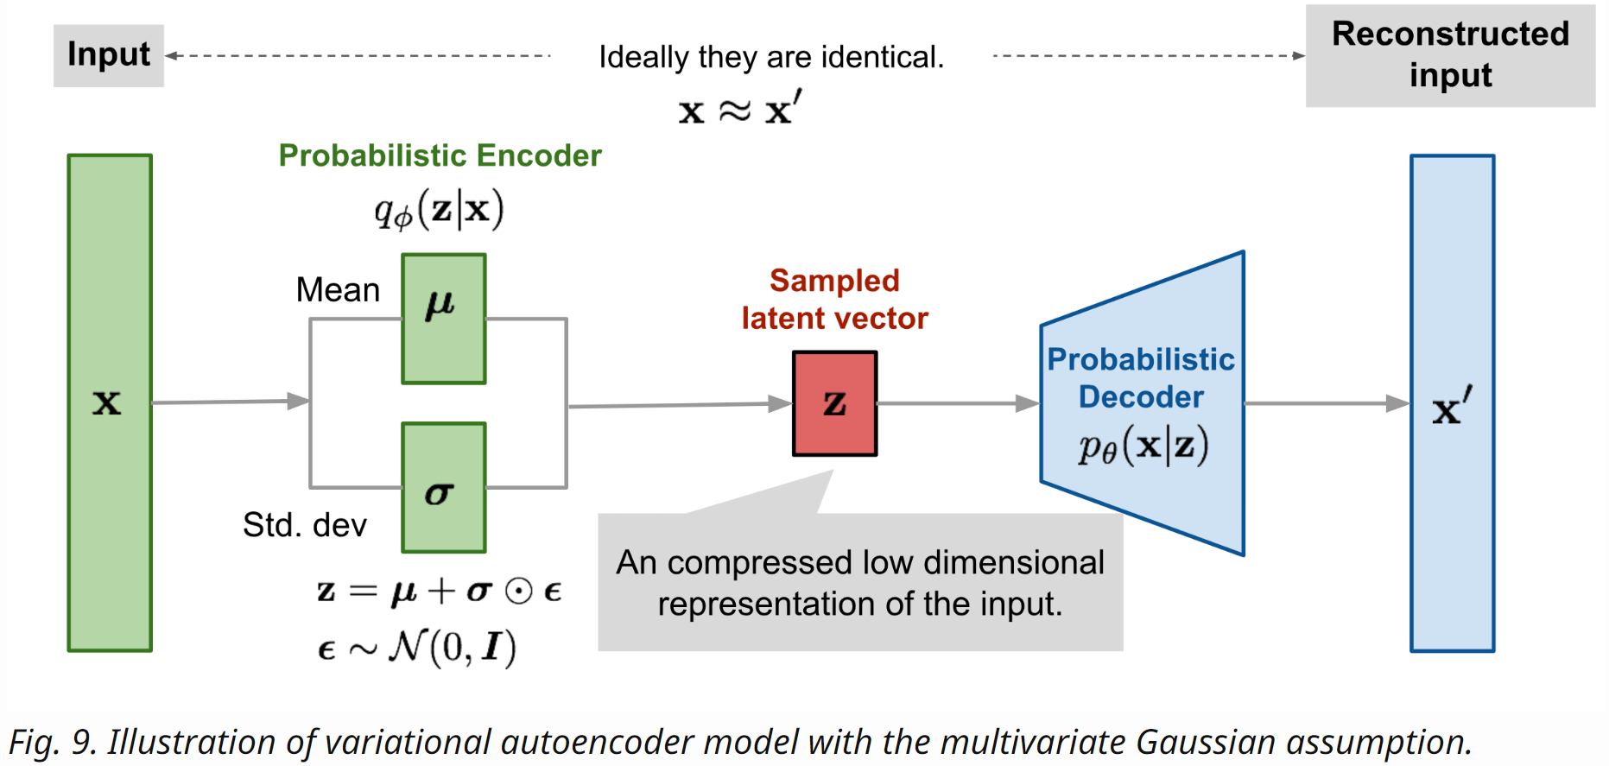
UNSUPERVISED LEARNING
VARIATIONAL AUTOENCODERS
https://lilianweng.github.io/lil-log/2018/08/12/from-autoencoder-to-beta-vae.html

Slide 18
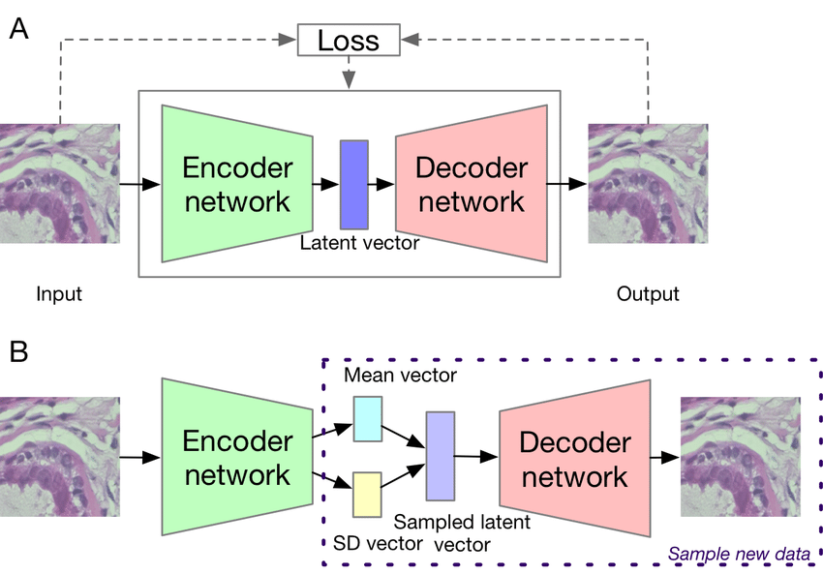
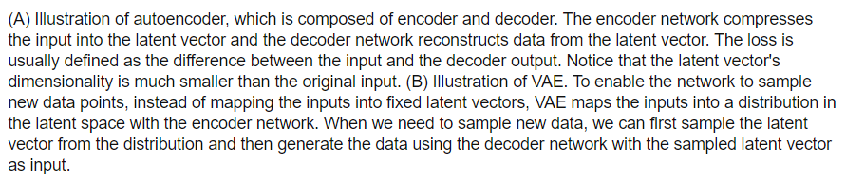
UNSUPERVISED LEARNING
VARIATIONAL AUTOENCODERS
https://www.researchgate.net/publication/331435145_Deep_learning_in_bioinformatics_introduction_application_and_perspective_in_big_

Slide 19
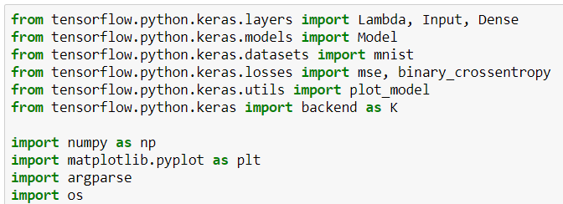
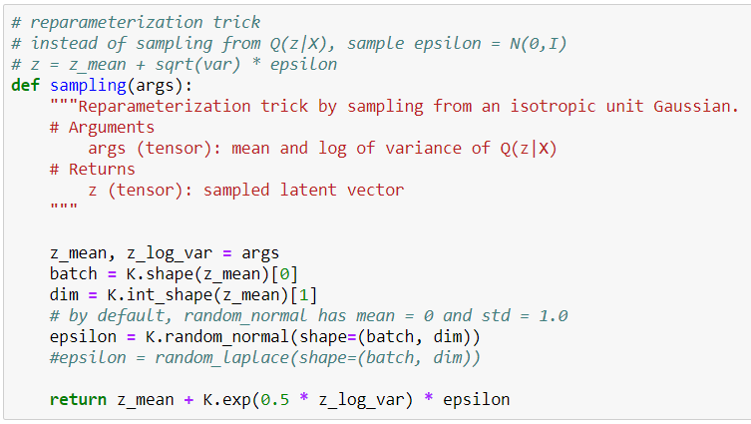
UNSUPERVISED LEARNING
VARIATIONAL AUTOENCODERS WITH KERAS
Force normal distribution
https://blog.keras.io/building-autoencoders-in-keras.html

Slide 20
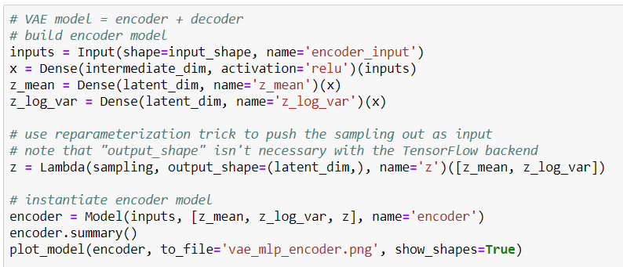
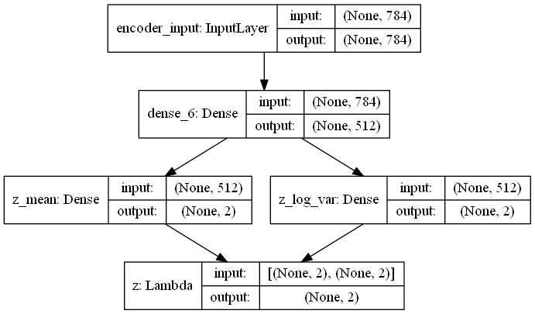
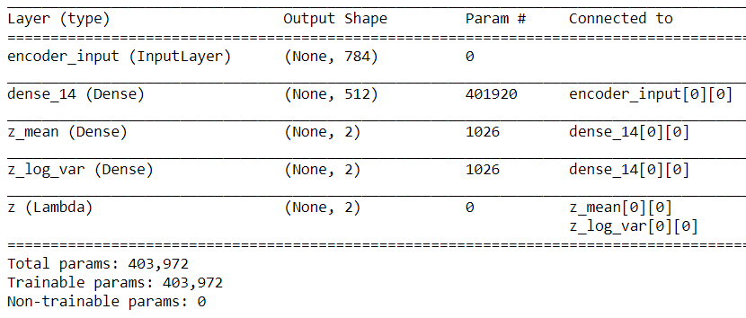
UNSUPERVISED LEARNING
VARIATIONAL AUTOENCODERS WITH KERAS
https://blog.keras.io/building-autoencoders-in-keras.html

Slide 21
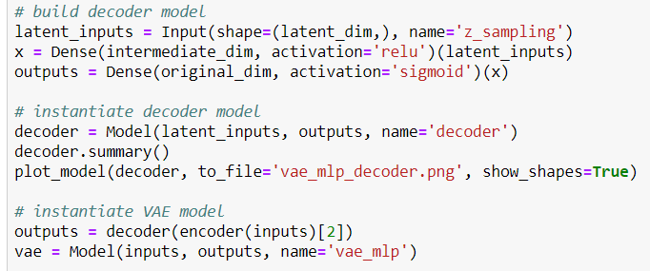
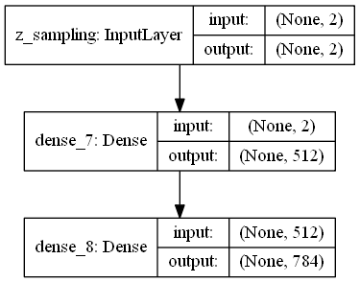
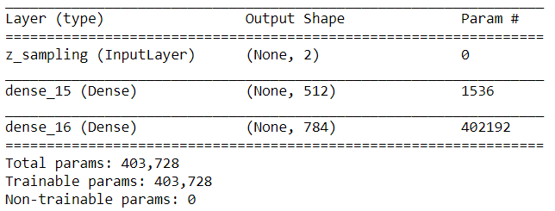
UNSUPERVISED LEARNING
VARIATIONAL AUTOENCODERS WITH KERAS
https://blog.keras.io/building-autoencoders-in-keras.html

Slide 22
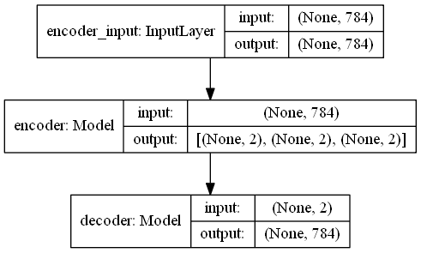
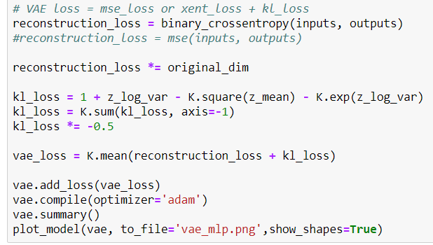
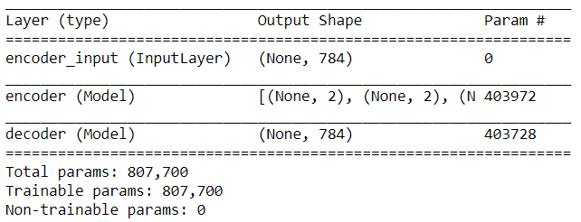
UNSUPERVISED LEARNING
VARIATIONAL AUTOENCODERS WITH KERAS
Force normal distribution
https://blog.keras.io/building-autoencoders-in-keras.html

Slide 23
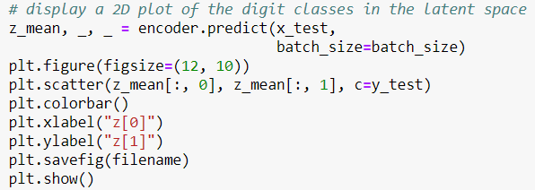
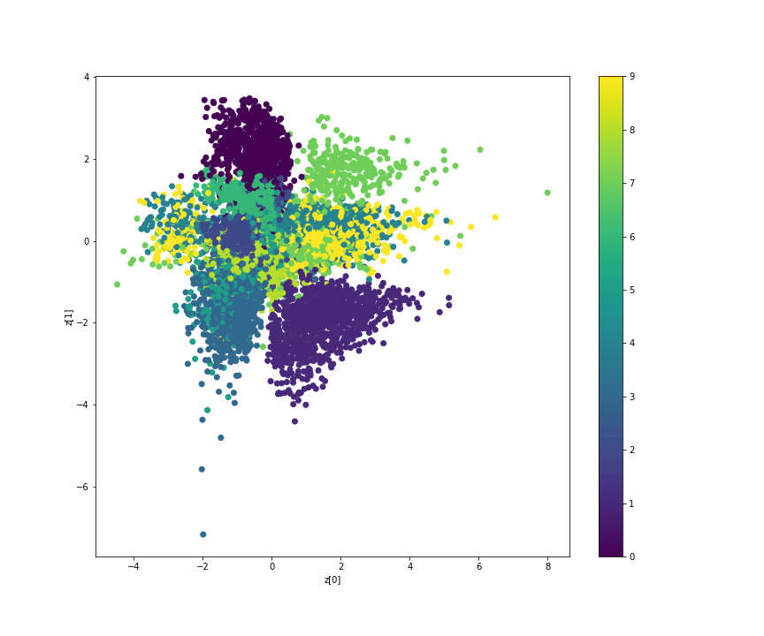
UNSUPERVISED LEARNING
VARIATIONAL AUTOENCODERS WITH KERAS
https://blog.keras.io/building-autoencoders-in-keras.html

Slide 24
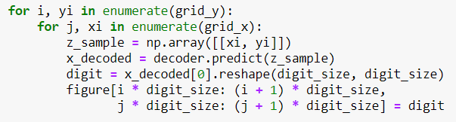
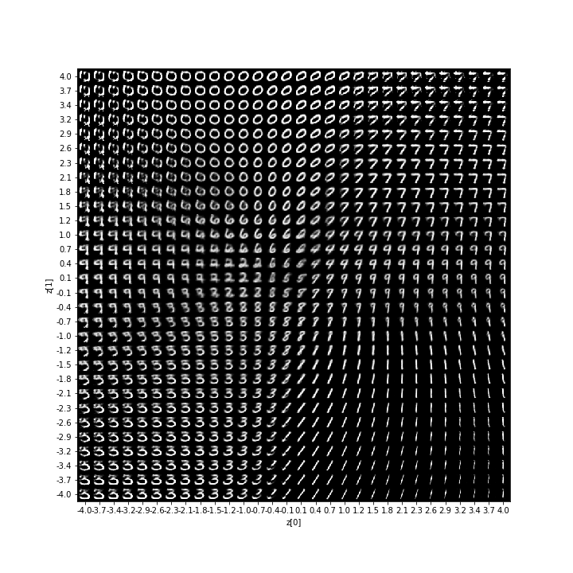
UNSUPERVISED LEARNING
VARIATIONAL AUTOENCODERS WITH KERAS
https://blog.keras.io/building-autoencoders-in-keras.html

Slide 25
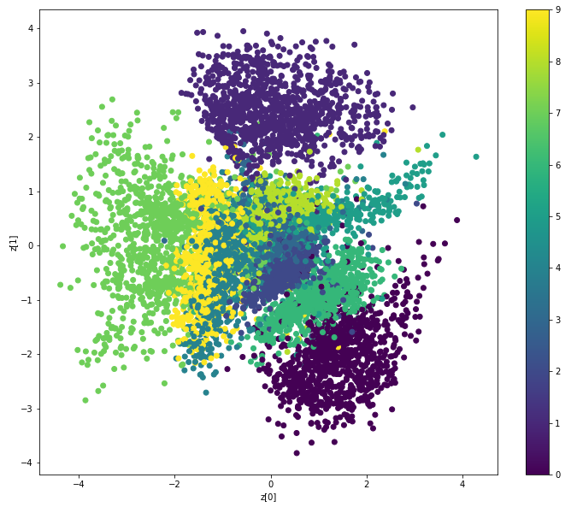
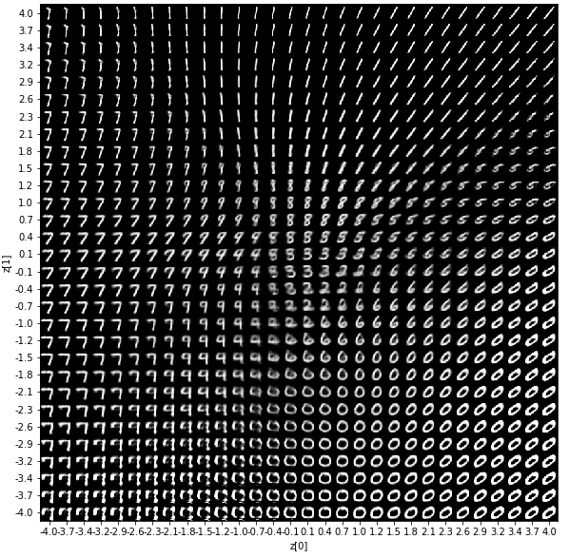
UNSUPERVISED LEARNING
VARIATIONAL AUTOENCODERS WITH KERAS
https://blog.keras.io/building-autoencoders-in-keras.html

Slide 26
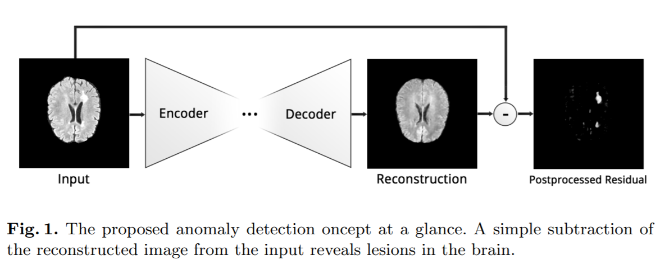
UNSUPERVISED LEARNING
AUTOENCODER ANOMALI DETECTION
https://arxiv.org/pdf/1804.04488.pdf

Slide 27
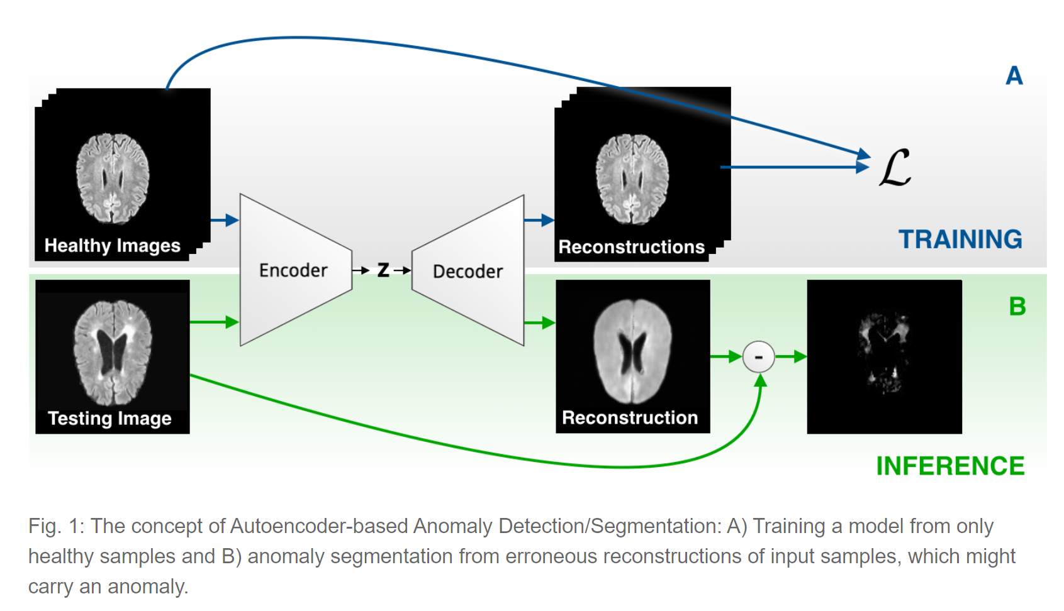
UNSUPERVISED LEARNING
AUTOENCODER ANOMALI DETECTION
https://arxiv.org/pdf/1804.04488.pdf

Slide 28
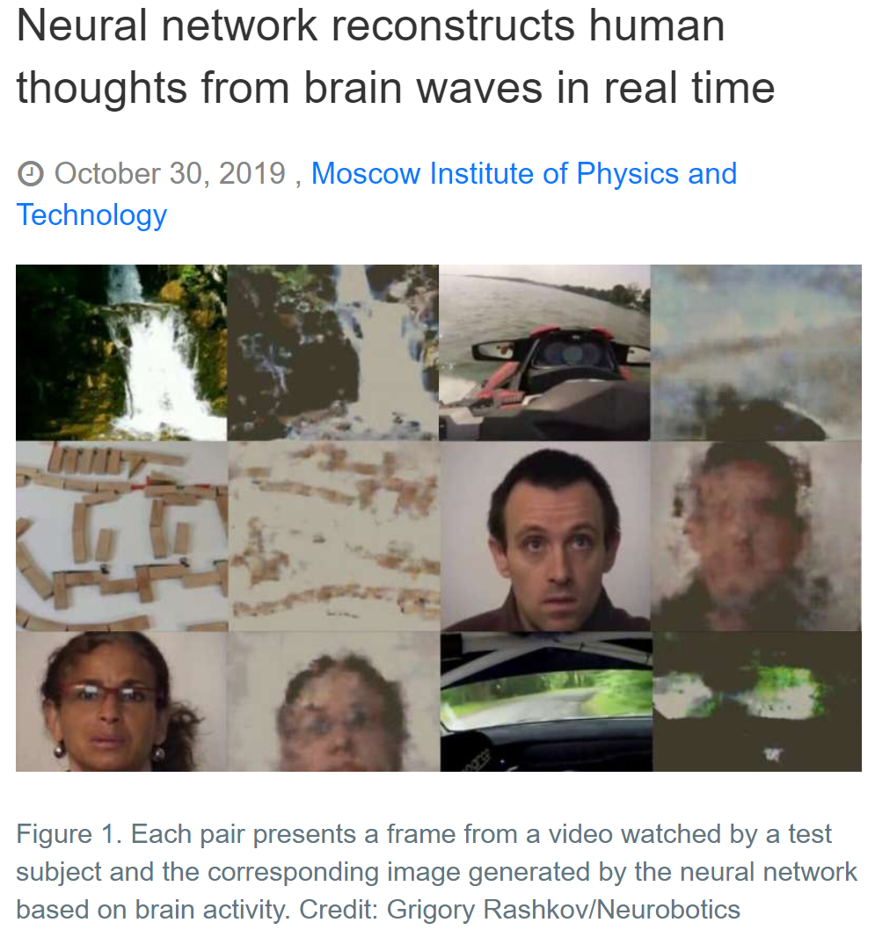
UNSUPERVISED LEARNING
AUTOENCODERS CRITICAL CASE STUDY
https://m.techxplore.com/news/2019-10-neural-network-reconstructs-human-thoughts.html?fbclid=IwAR3isTrSw3PkLAce1N40l4Ui0caVC_iIp_um5sL-B-2MkofHKpGrA3xPGak

Slide 29

UNSUPERVISED LEARNING
DOES THE BRAIN DO IT?

Slide 30

UNSUPERVISED LEARNING
DOES THE BRAIN DO IT?

